Slide 1
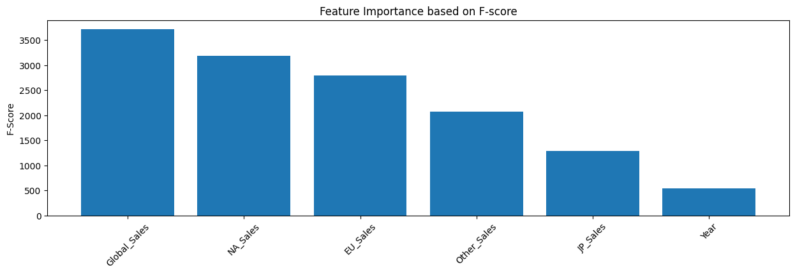
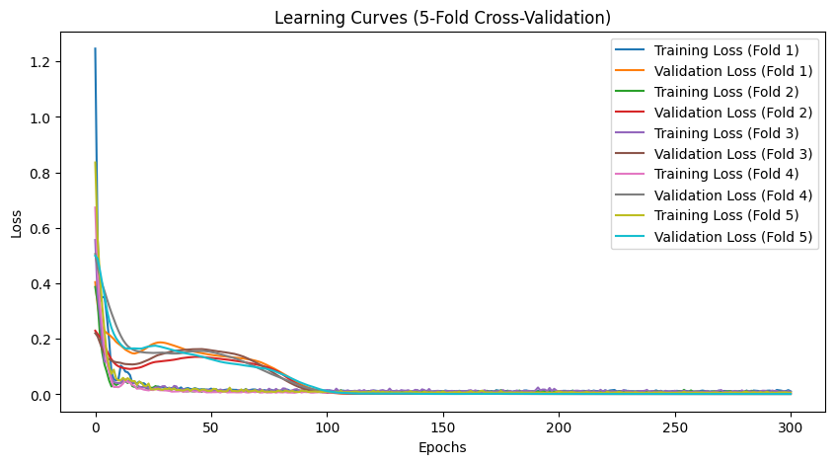
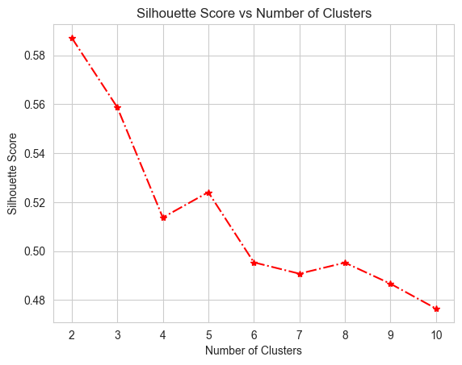
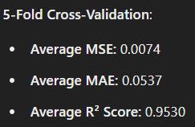
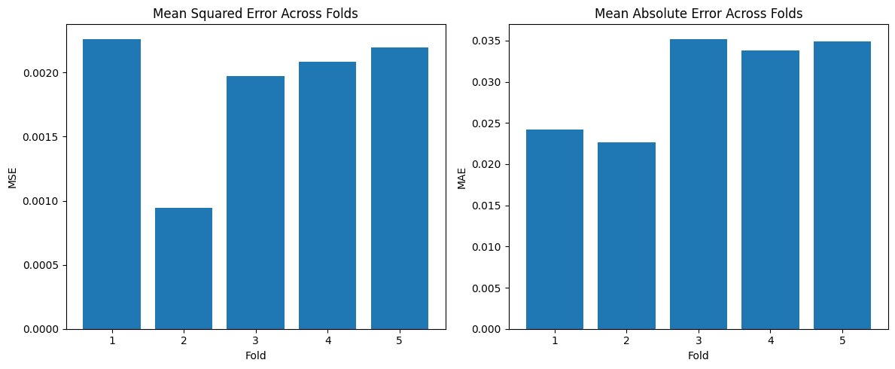
Game rankings can be predicted precisely by regional sales data in different types neural network models. while hierachical clustering reveals distinct patterns in sales performance, platform preferences, and genres.
Non-Cognitive Predictors of Student Success: A Predictive Validity Comparison Between Domestic and International Students
Non-Cognitive Predictors of Student Success: A Predictive Validity Comparison Between Domestic and International Students
Title: Video Games Sales Analysis and Model Evaluation
Vy Nguyen, Huy Vuong
INTRO
Video game sales drive a multi-billion-dollar industry, influencing development, marketing strategies, and consumer trends. Understanding sales patterns can help publishers optimize releases and target markets more effectively.
METHODS
Linear Regression: Predicted global sales using regional sales data.
Neural Network: Predicted game ranks with selected features and scaled data.
K-Means Clustering: Grouped games into five clusters based on sales and attributes, visualized with PCA.
Hierarchical Clustering: Explored nested relationships in sales patterns using dendrograms.
RESULTS
Linear Regression: Achieved high accuracy with an R² score of 0.955, effectively predicting global sales from regional sales data.
Neural Network: Predicted game ranks with minimal error, showing low MSE and MAE values, validated through cross-validation.
K-Means Clustering: Shows poor performance due to the even distribution of the data.
Hierarchical Clustering: Uncovered nested relationships among games, highlighting subgroups within broader clusters.
Hierarchical Clustering Optimal # of Clusters
Linear Regression Evaluation
Notes:
Notes:
In Powerpoint, click View > Guides
Keep text within gutter guides.
Author list: Don’t split names onto two lines (e.g., “Jimmy [break] Smith”). If that happens, use a new line, unless you need the space. Bold the first names of anybody who’s presenting in person.
Intro/methods/result: Do not drop below font size 28, but if you have extra space, jack up the font size until the space is full.
Do not use color in the sidebars except in graphs/figures. It’ll pull attention from the center and slow interpretation for passersby.

Slide 2

Video Games Sales
Vy Nguyen
Huy Le Vuong

Slide 3
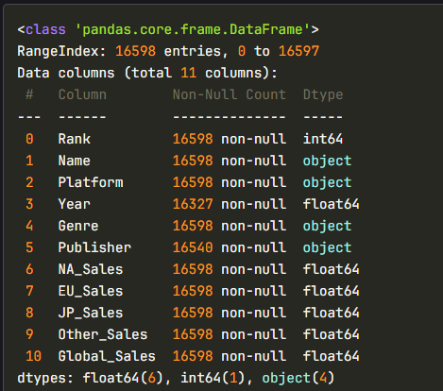
Data exploration

Slide 4
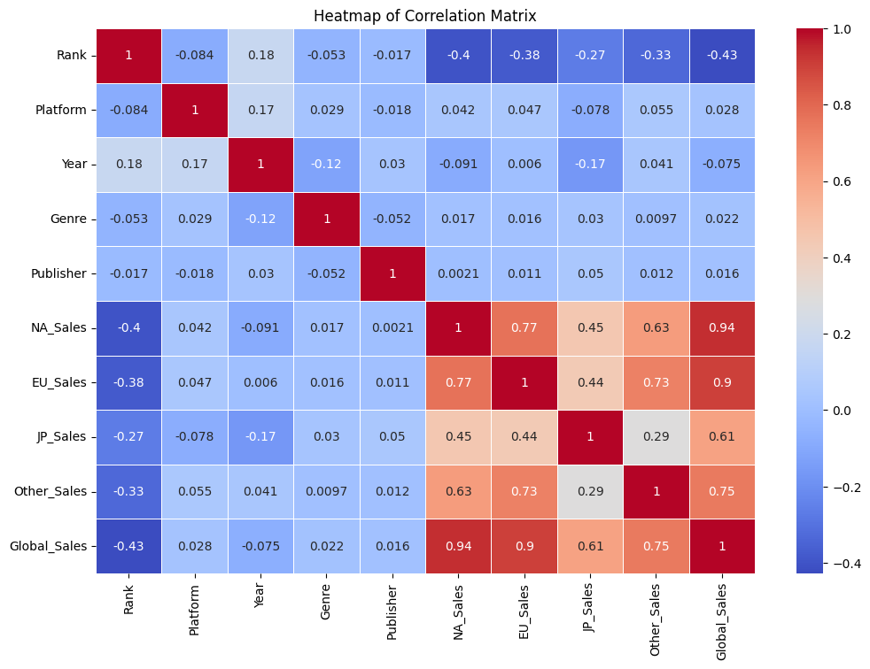
Columns Correlation

Slide 5
Features selection

Slide 6
Linear Regression

Slide 7
Methodology
Objectives:
Predict Global_Sales based on features such as NA_Sales, EU_Sales, JP_Sales, and Other_Sales.
Data Preparation:
Feature Selection: Selected regional sales features.
Data Cleaning: Handled missing values.
Normalization: Applied Box-Cox transformation to address skewness.
Train-Test Split: Split data into 80% training and 20% testing.
Cross-Validation:
5-Fold Cross-Validation: Evaluated model performance by averaging metrics across 5 folds.

Slide 8
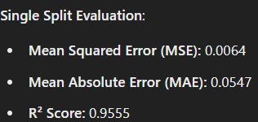
Finding
Performance Metrics:
Insight:
The Linear Regression model performed well, with high R² scores and low error metrics, indicating strong predictive capability.
Further testing with advanced models can validate and refine these results.

Slide 9
Hierarchical Clustering

Slide 10
methodology
Objective:
Group video games with similar sales patterns and characteristics.
Steps:
Applied PCA to reduce data to 2 dimensions for visualization.
Used Complete Linkage to calculate inter-cluster distances.
Plotted a dendrogram to visualize the hierarchical structure.
Utilize Silhouette scores for Analysis

Slide 11
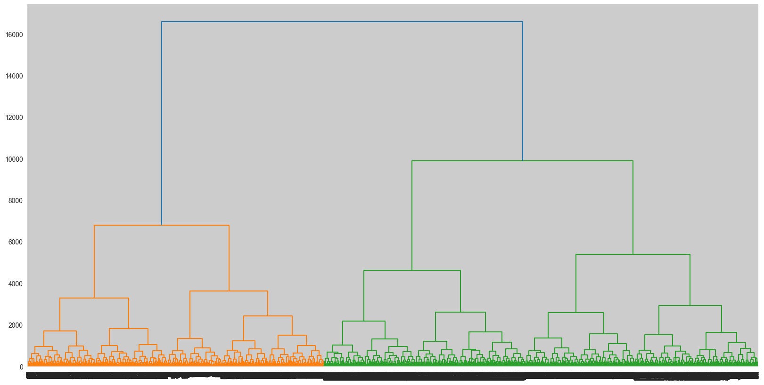
Finding
Key Observation:
Dendrogram Analysis:
Suggested 2 clusters as an optimal cut-off based on the tree structure.
Silhouette Score Analysis:
Suggested 5 clusters as providing better-defined groupings.
Takeaway:
Hierarchical clustering revealed meaningful groupings, but the results varied based on the evaluation method.

Slide 12
K-mean Clustering

Slide 13
Methodology
Objective:
Group video game sales data into clusters based on similar attributes.
Data Preprocessing:
Handled missing values using forward and backward filling.
Encoded categorical variables (Platform, Genre, Publisher) using LabelEncoder.
Removed non-numeric columns like Name for clustering.
Clustering Algorithm:
KMeans: with 5 clusters
Reduced features to 2 principal components for visualization.

Slide 14
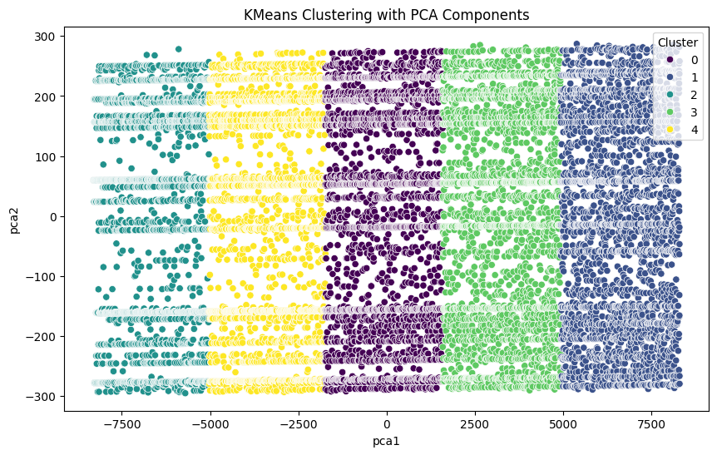
Finding
The PCA scatter plot shows that clustering methods might not work as the data is evenly distributed and not forming any cluster.

Slide 15
Neural network

Slide 16
Methodology
Objectives:
Predict video game ranks.
Preprocessing
Feature selection: Selected on top features.
Model Design:
Activation Function: Relu activation for non-linearity.
Loss Function:
Regression: Mean Squared Error (MSE)
Classification: Cross Entropy Loss.
Cross-Validation:
5-Fold Cross-Validation for robust performance evaluation.

Slide 17
Methodology comparisons
Neural Network Types
Regression |  |  | Classification
With Feature Selection |  | Without Feature Selection
RobustScaler | MinMaxScaler
Low loss and low mean absolute error. Train Loss: 0.0154 Validation Loss: 0.0221 Mean Squared Error: 0.0226 Mean Absolute Error: 0.0471 | Low loss and low mean absolute error. Train Loss: 0.0014 Validation Loss: 0.0007 Mean Squared Error: 0.0016 Mean Absolute Error: 0.0280 | High loss and high mean absolute error. Training Loss: 92026328.0000 Validation Loss: 90543288.0000 Mean Absolute Error: 8239.3281 | Fairly low amount of losses but requires a larger output sizes if we want to predict more rankings. This approach has limited scalability. We will try regression neural network next. Loss: 8.7682

Slide 18
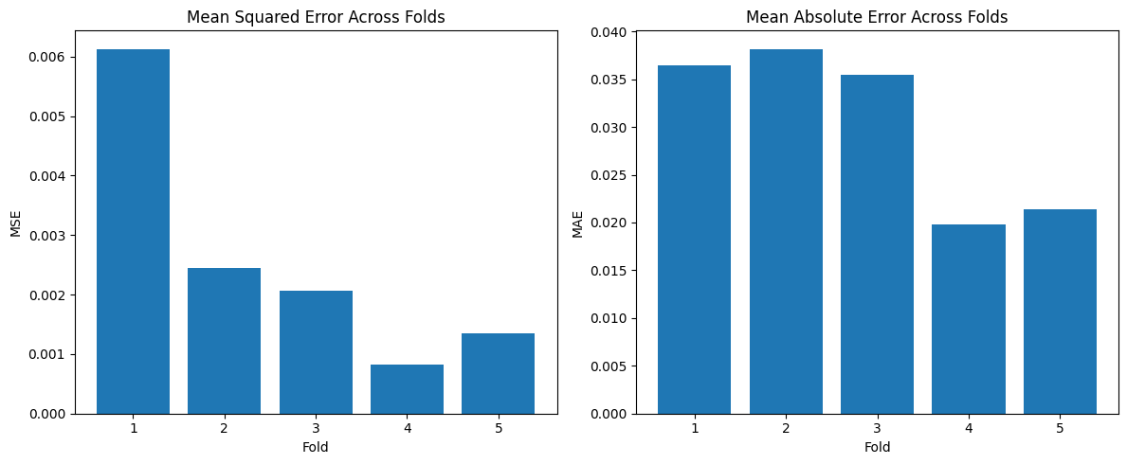
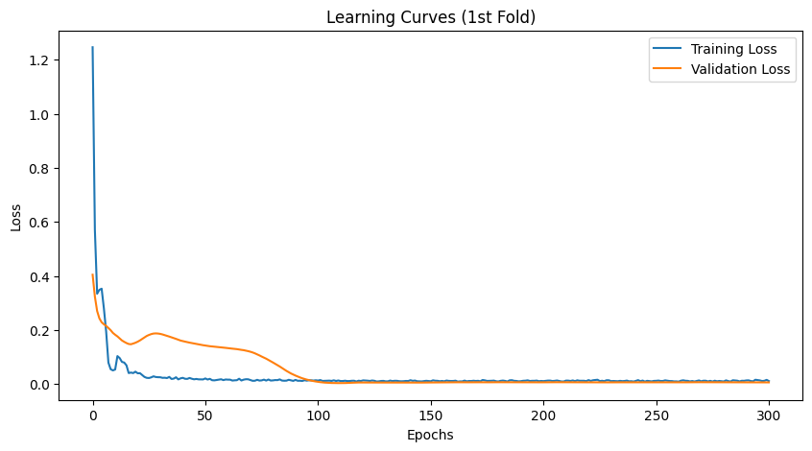
Finding
Regression Neural Network with Feature Selection with MinMaxScaler or RobustScaler models have good learning curves and low mean-square error and mean-absolute error.

